Slide 1

Smart Agriculture System Using IoT A Project Report Submitted as a training project for The Smart Bridge May 2020- June 2020 By Gaurav Baghel Under the Guidance of Mr. Durga Prasad Bethi durgaprasad@thesmartbridge.com

Slide 2
The main aim of this project is to turn on and off water pump from anywhere using mobile phone.
Smart Agriculture System based on IoT can monitor soil moisture and climatic conditions to grow and yield a good crop.
The farmer can also get the real time weather forecasting data by using external platforms like Open Weather API.
Farmer is provided a mobile app using which he can monitor the temperature , humidity and soil moisture parameters along with weather forecasting details.
Based on all the parameters he can water his crop by controlling the motors using the mobile application.
Even if the farmer is not present near his crop he can water his crop by controlling the motors using the mobile application from anywhere.
Even if the farmer is not present near his crop he can water his crop by controlling the motors using the mobile application from anywhere.
This can be a ground-breaking invention for people still using traditional agricultural techniques.

Slide 3
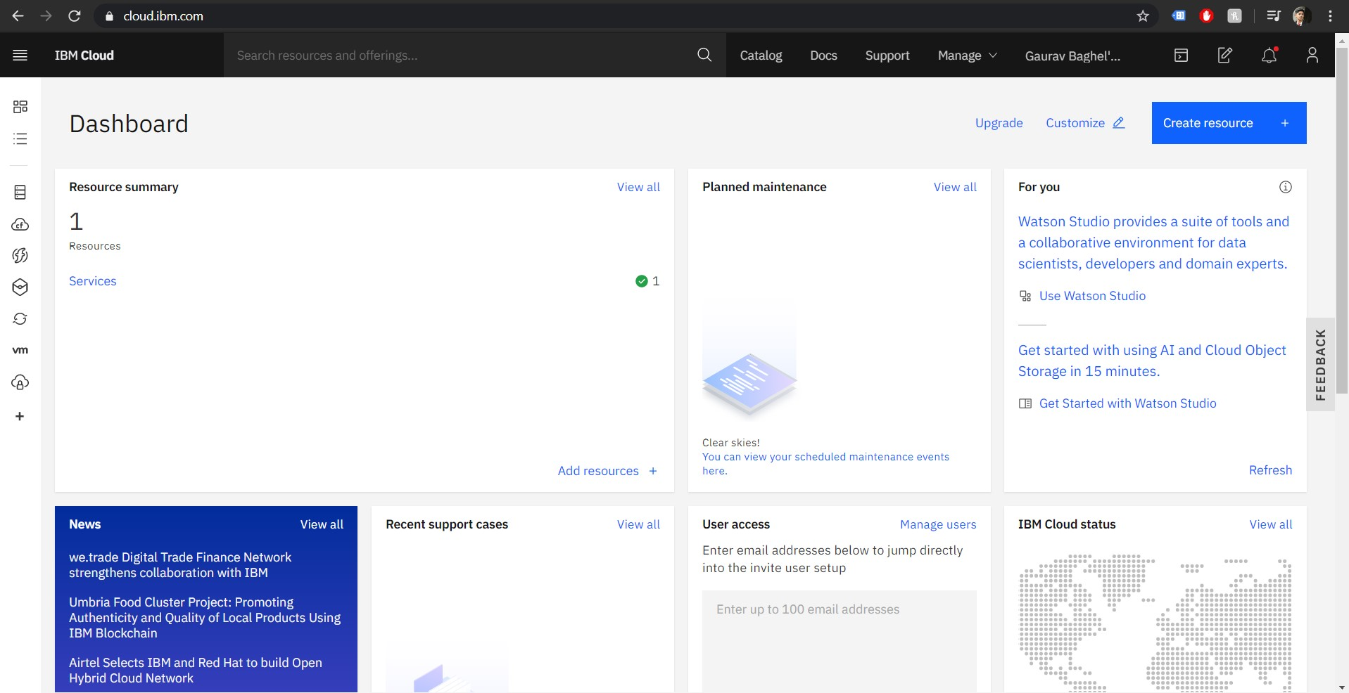
Project Requirements:
IBM cloud account
IOT Application Development
IOT cloud platform
Basic python requirements.

Slide 4
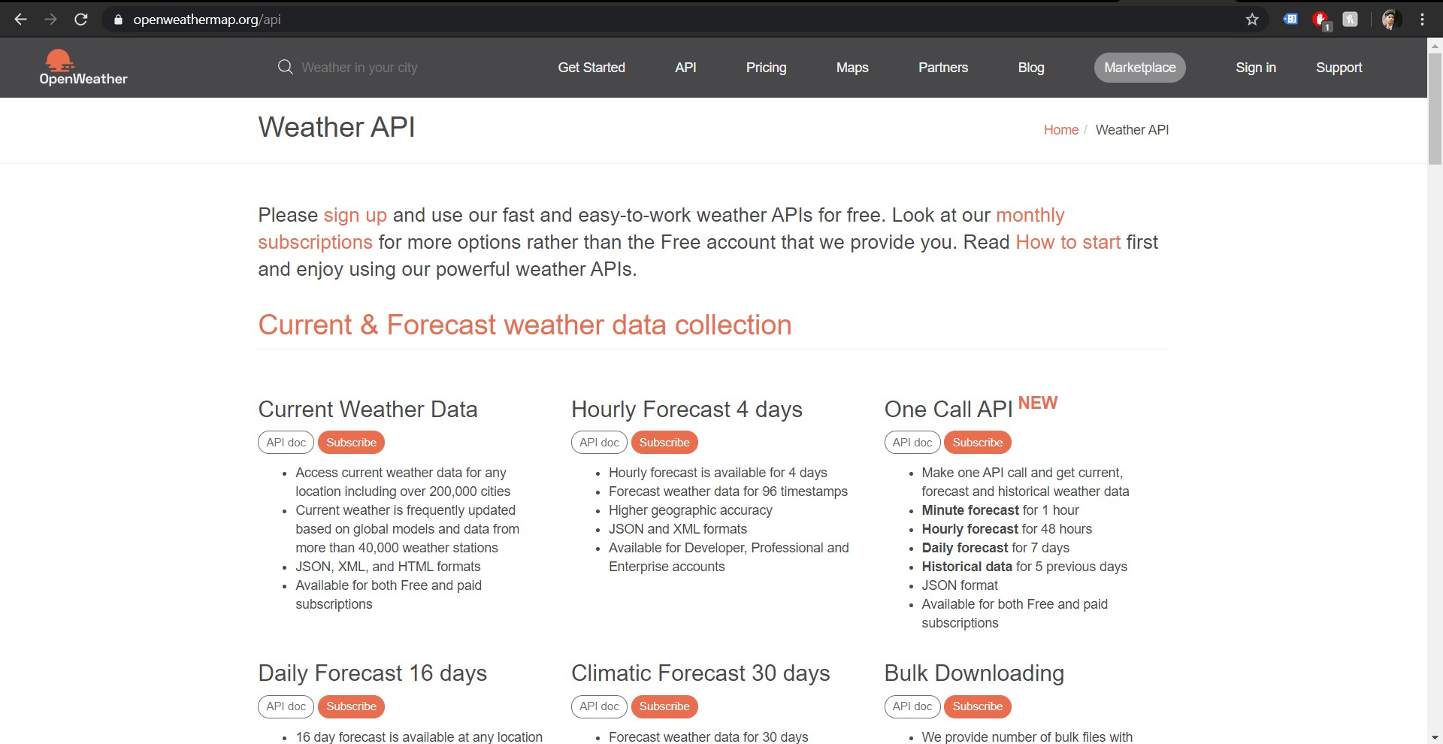
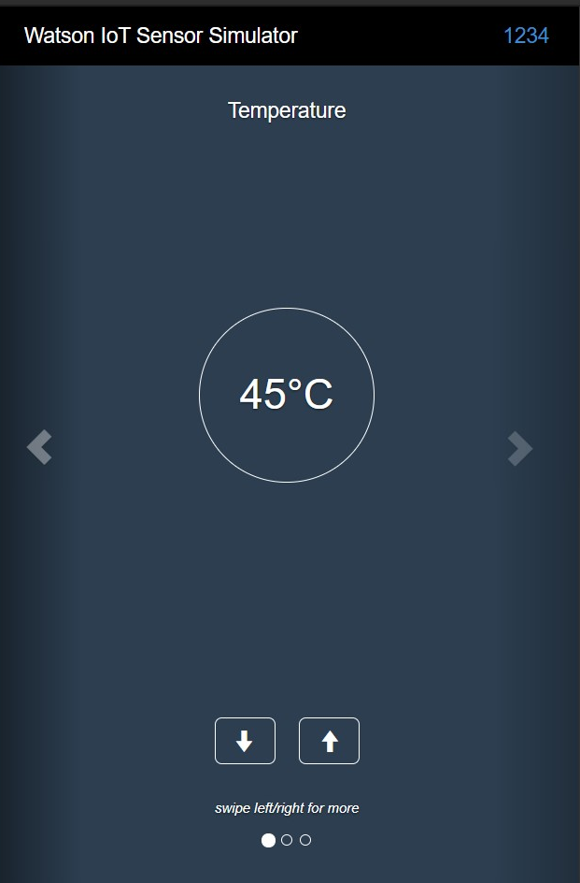
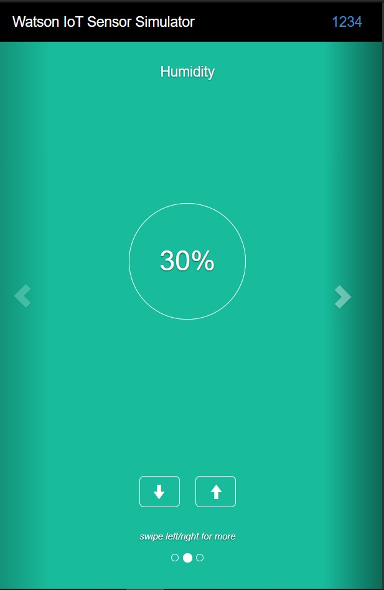
Functional Requirements:
Open Weather API that could deliver real time weather forecasting.
Online IoT Simulator to get external factors like temperature , humidity and soil moisture

Slide 5
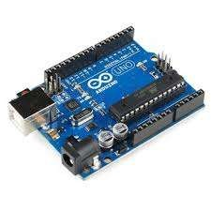
Technical Requirements:
The program is to be written in python and we will be using IBM cloud account too along with IoT simulator to IoT Watson platform, Nodes to get data and make a web page.
Arduino Uno
Analog Soil Moisture Sensor
DHT22 Digital Temperature and Humidity Sensor
MQ-135 Air Quality Gas Sensor Module
MQ-7 Gas Tester Carbon Monoxide Detecting Sensor Module 4P 180mA 5V DC
MQ2 Gas Sensor, Methane, Butane, LPG, Smoke Sensor
Ultrasonic sound sensor
LCD 16×2 Alphanumeric Display(JHD162A)
Jumper Wires Male to Male, male to female, female to female
GSM Modem Module for Arduino
Batteries
Motor
1 kilo-ohm Resistances

Slide 6
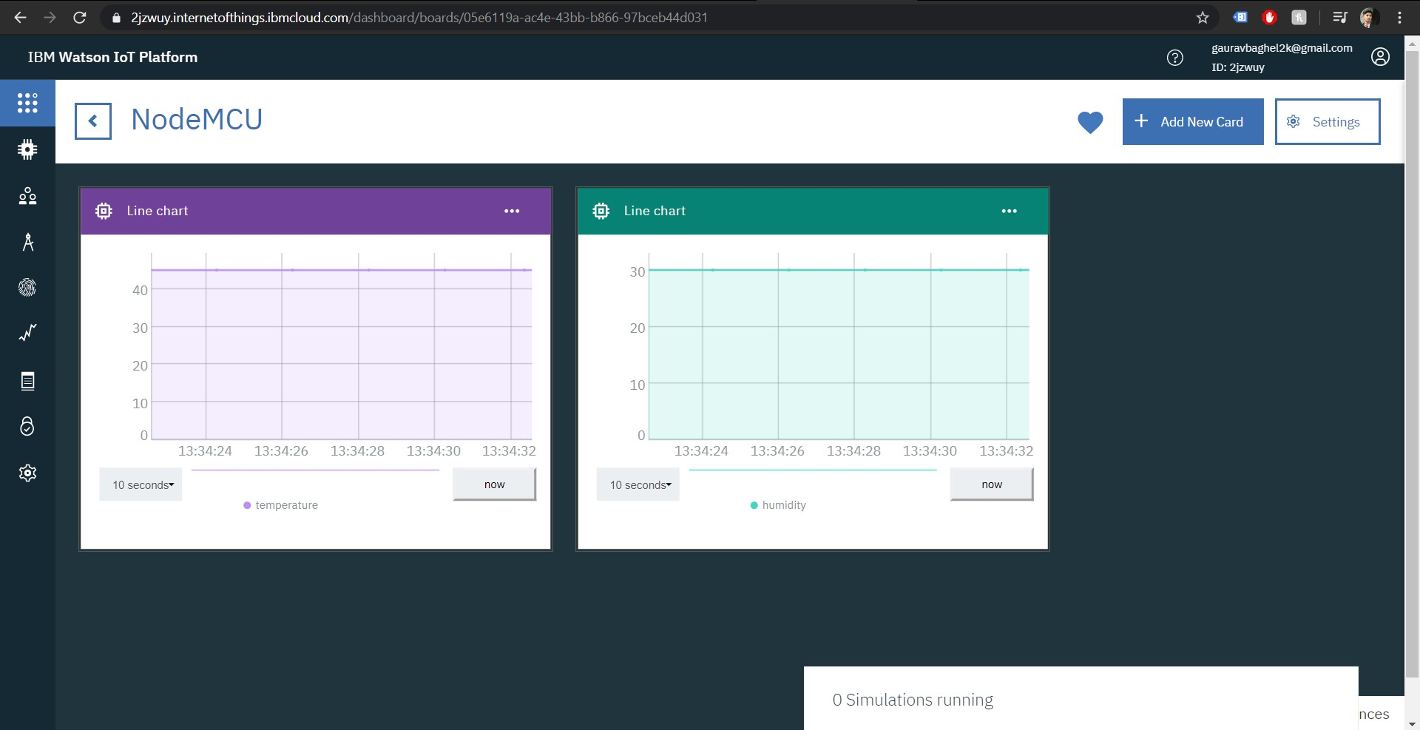
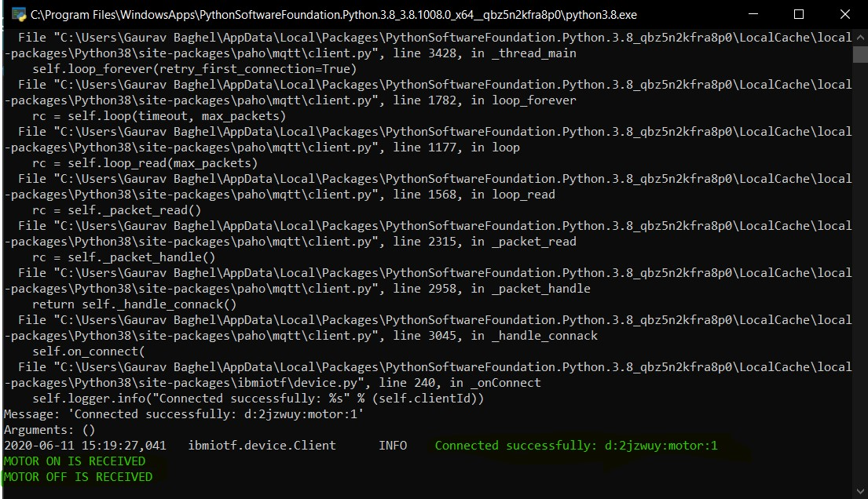
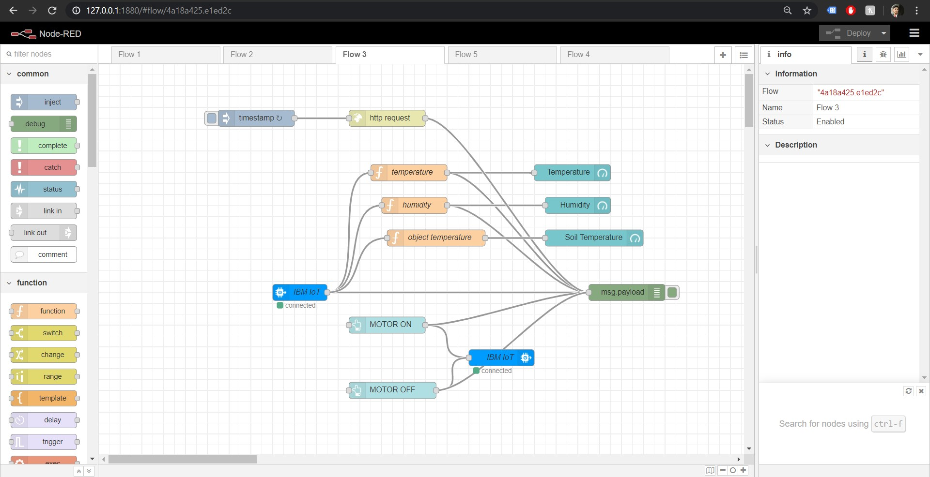
Software Requirements:
IBM cloud
Python
Open weather API
Nodes

Slide 7

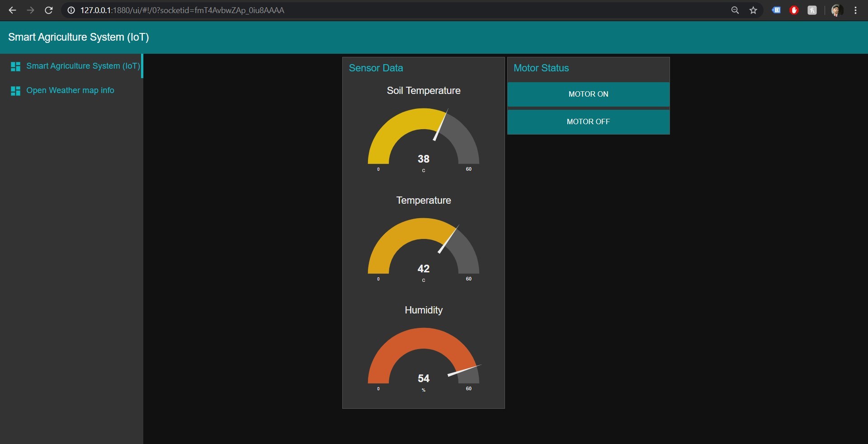
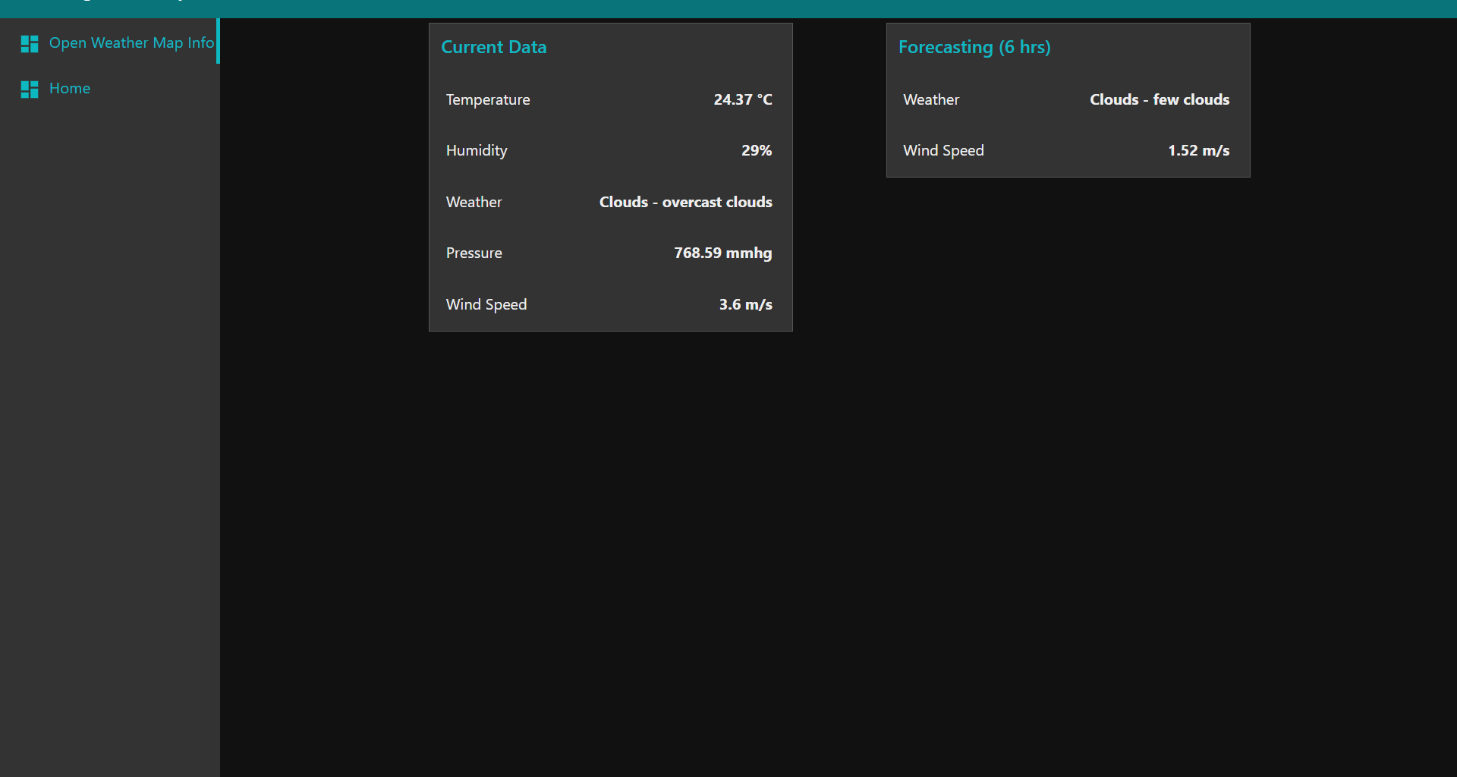
Project Deliverables:
An mobile application that can monitor the temperature , humidity and soil moisture parameters along with weather forecasting details. Also, based on these parameters user can water his crops by controlling the motors.

Slide 8
Thank You !

